Slide 1
Journey pitch
Morgan Hodge
BSc (Hons) Computing and Games Development
10779528

Slide 3
Mind Map 2

Slide 4
SWOT

Slide 5
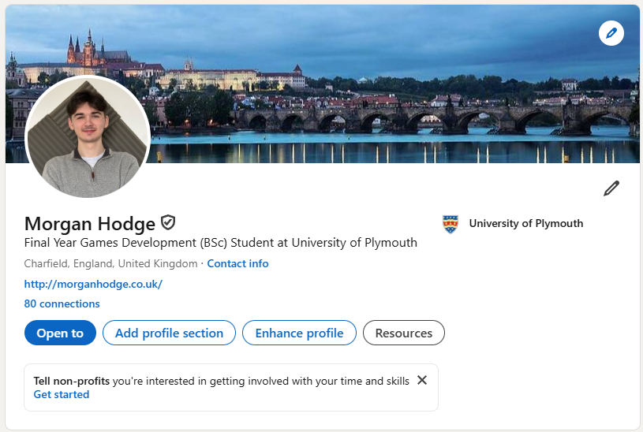

Slide 6
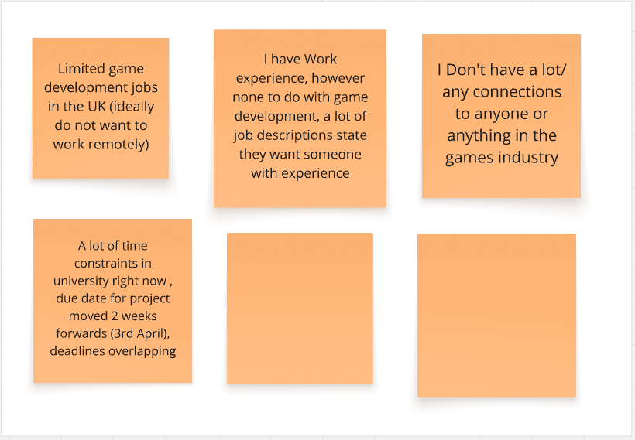

Slide 7
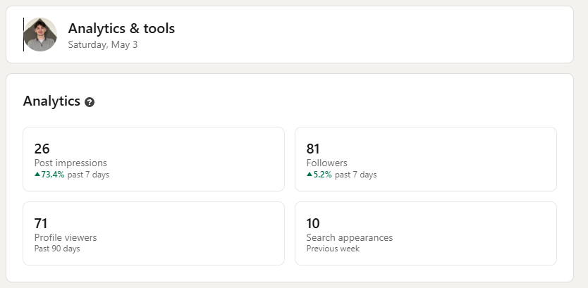

Slide 8
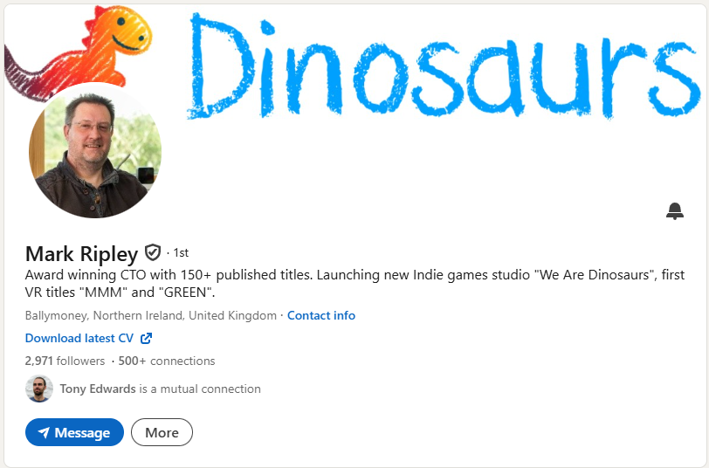
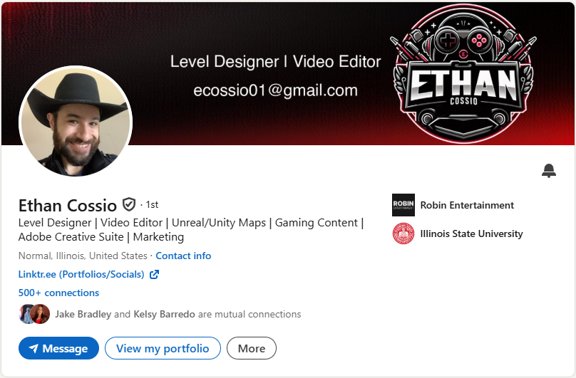
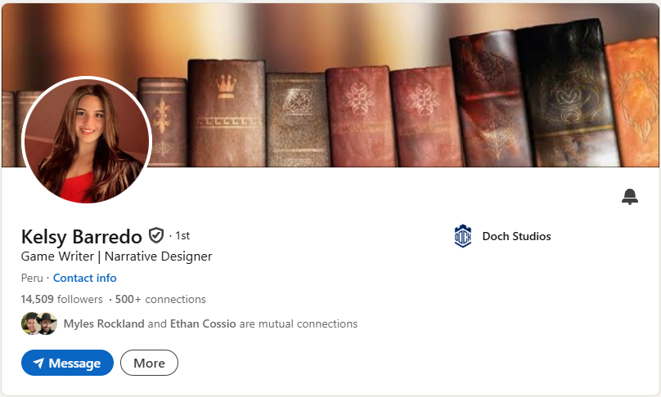
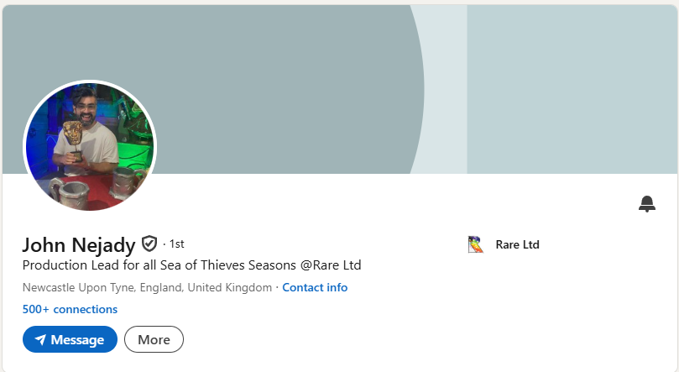

Slide 9
retrospective

Slide 10
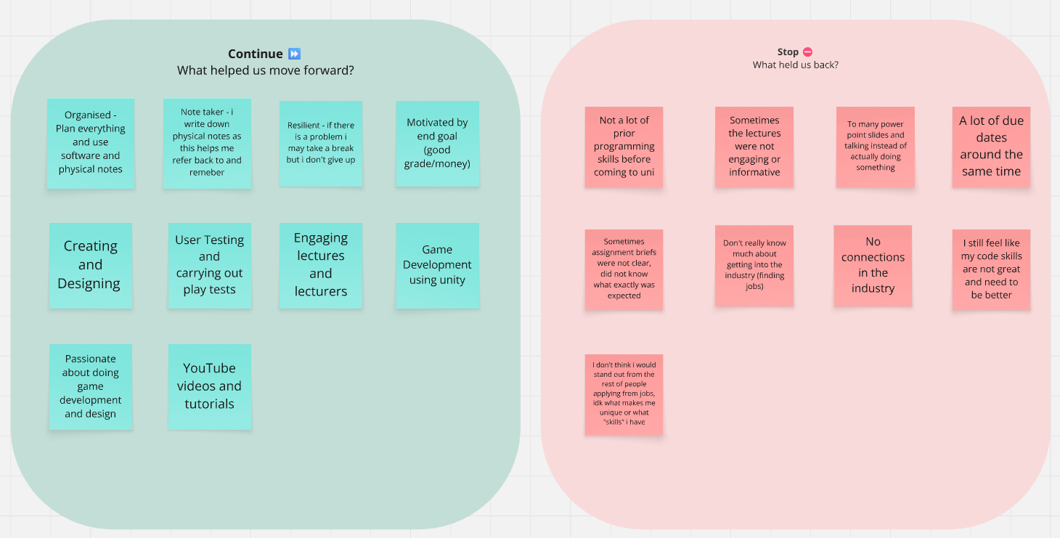

Slide 11
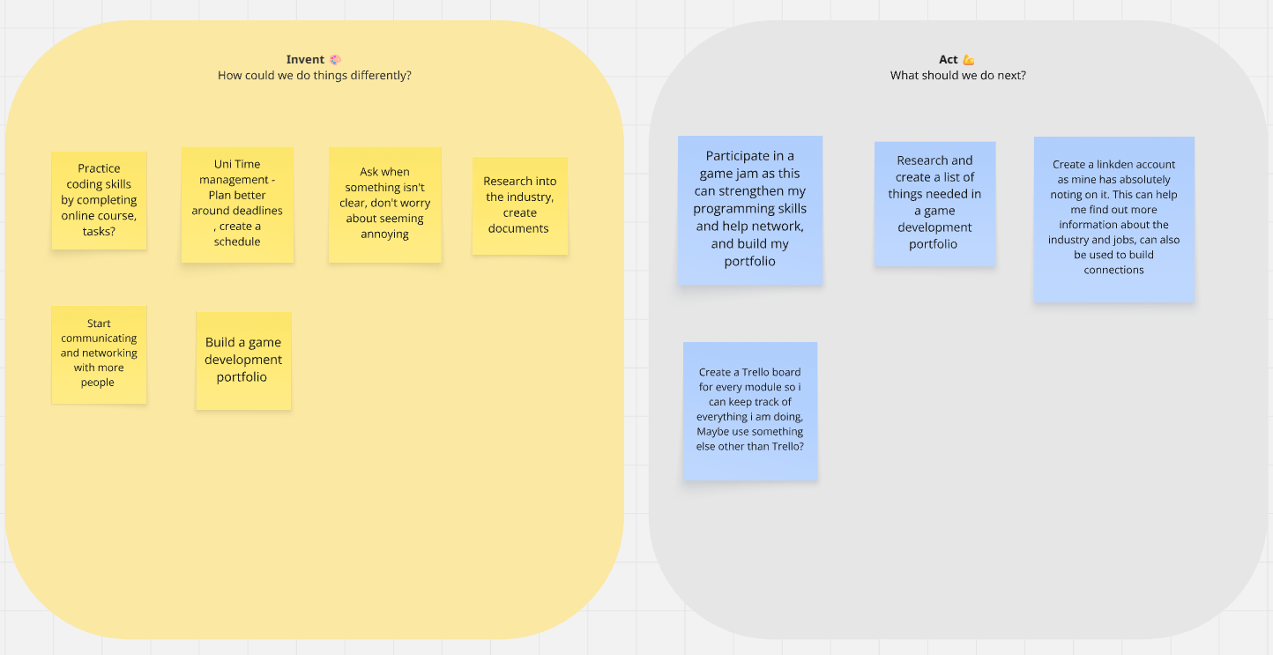

Slide 12
User Stories

Slide 13
MAIN GOALS
Find a Job in games development
Create A social presence that will help to get me noticed
Create a portfolio that displays information about me and my work

Slide 14
SMART GOALS

Slide 15
timeline

Slide 16
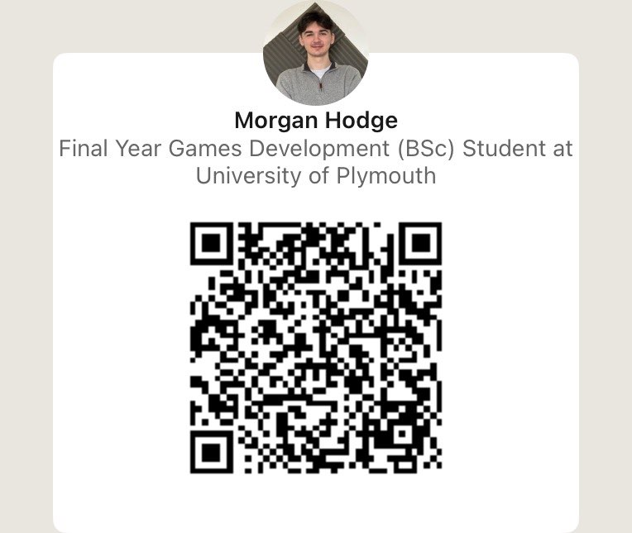
Resources
Planning documents displayed in this video are in the GitHub repository :
https://github.com/Mdot5596/Industry-Engagement
Game Jams and Itch profile can be found here : https://morganhodge.itch.io
My portfolio website: https://morganhodge.co.uk/
My LinkedIn: https://www.linkedin.com/in/morgan-hodge-860854256/
Thank You For Watching ☺

Slide 17
Final notes

Slide 18
Implementation

Slide 19
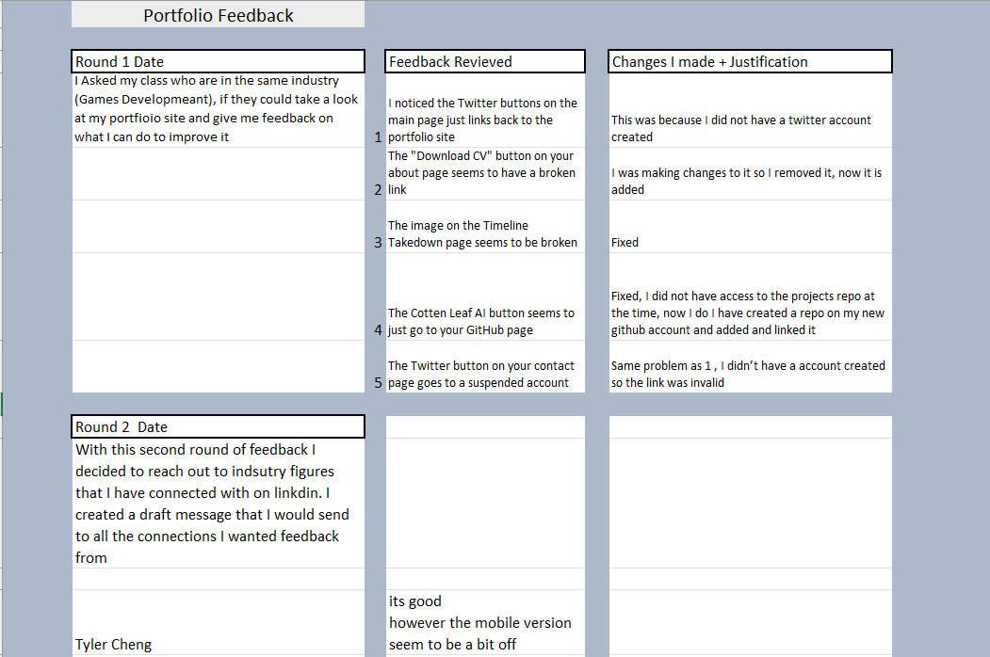

Slide 20
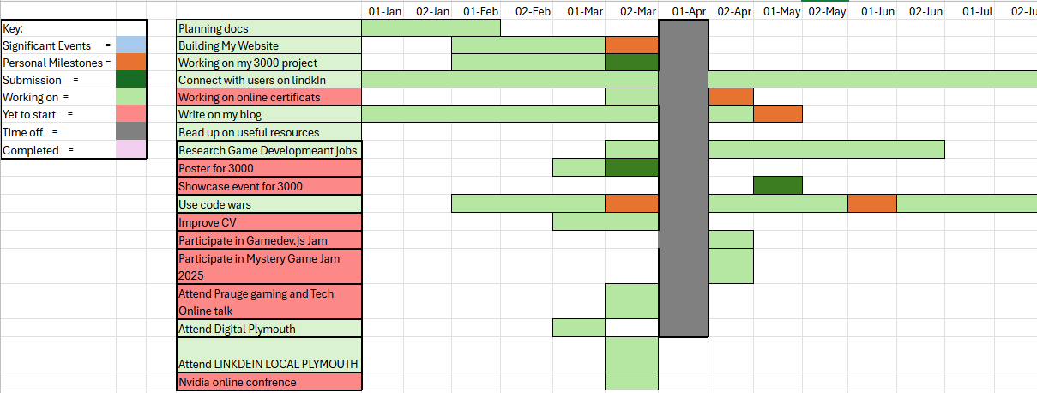

Slide 21
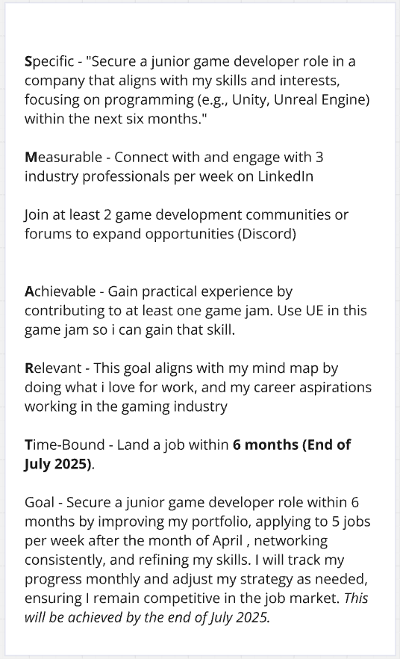
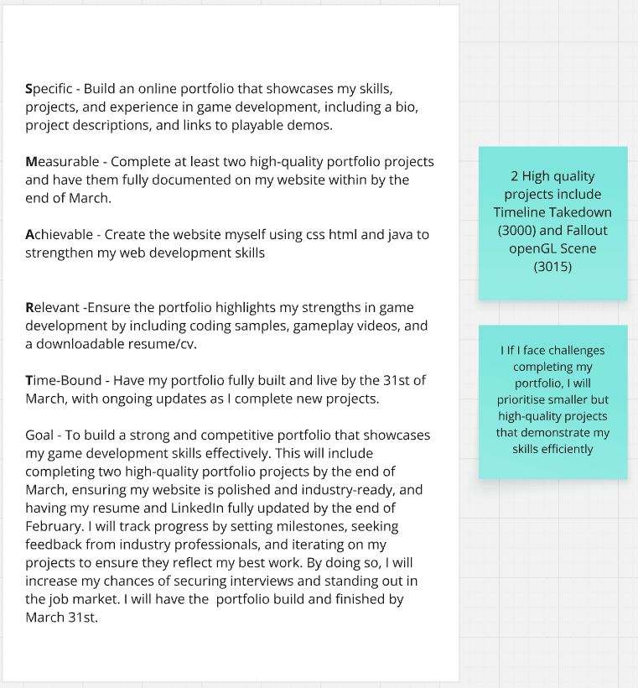

Slide 22
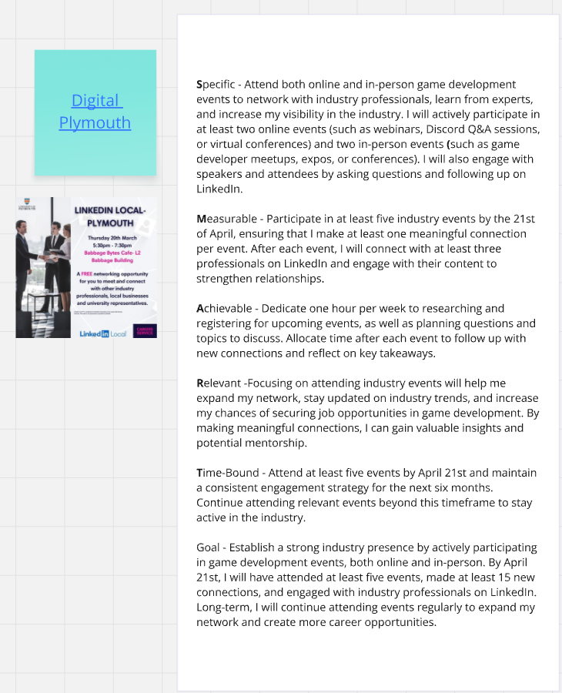
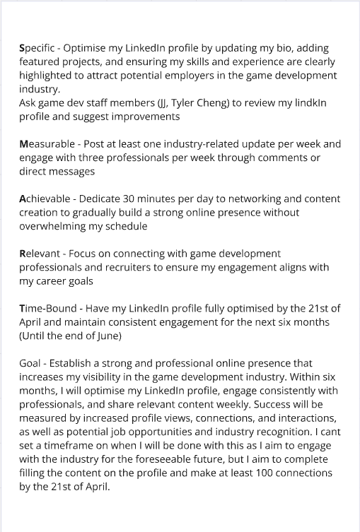

Slide 24
Digital Plymouth
Networking
Analytics
Images

Slide 25
Job
Strengthen skills -> GameJam – Show Gamejam – 2D games never done before

Slide 26
My website
Networking
Analytics
Images

Slide 27
GameJams

Slide 28
Talk about the plan stuff
highlight the initial strategy identified using smart objectives
outline action taken
roadmap planned
key milestones achieved
external interest or recognition of the process/product

Slide 29
Key Milestones achieved
When talking about digital Plymouth say how I know its not specifically games industry, but it does not say a specific industry, so it was worth going to encase
Gave website to industry people thro LinkedIn
Started with no LinkedIn ( show ) and ended up where I am

